Slide 1
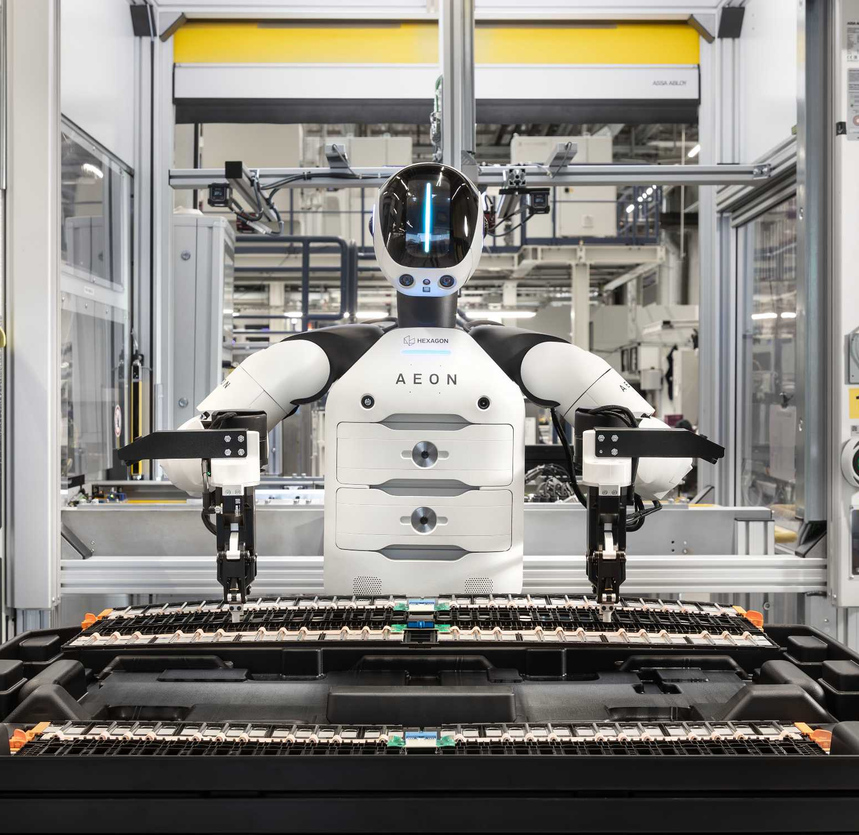
Case Study
State of
Technology in
Automotive
Market outlook, technology trends
and implications for a global
automotive bid
Prepared by Rajat | 19 September 2026

Slide 2
Global Vehicle Demand Is Set to Soften in 2026
Global sales face a near-term dip, while Asia and electrification shape the market’s direction.
Global sales outlook
2025 geographic mix
2025 vehicle type
LIGHT VEHICLES
Global annual sales, million units
ALL MOTOR VEHICLES
2025 total: 99.8m units
PASSENGER CARS
Approximate 2025 powertrain mix
July 2026 forecast
−3.3% YoY
+2.8% YoY
2025–26
2026–27
Asia, Oceania and the Middle East
account for 55% of sales.
One in four new cars was plug-in.
Non-plug-in includes conventional hybrids.
2027 remains 0.5m below 2025.
Insight
Different vehicle definitions apply to each chart. Compare shares within each pie. The totals are not directly comparable.
Sources: Mobility Global; OICA; IEA
Case Study | State of Technology in Automotive
2
Notes:
Mobility Global, “Japan earthquake stalls auto assembly lines”, 5 August 2026. Section: Forecast assumptions as of July 2026
https://www.mobilityglobal.com/en-us/automotive-insights/rapid-impact-analysis/japan-earthquake-stalls-auto-assembly-lines#forecast-assumptions-as-of-july-2026
Mobility Global, 2026 forecast chart
https://delivery-p189657-e1977718.adobeaemcloud.com/adobe/assets/urn%3Aaaid%3Aaem%3Ad861efe2-cc3e-4979-bfc0-3d21da80746f/as/mobility-8.avif
Mobility Global, 2027 forecast chart
https://delivery-p189657-e1977718.adobeaemcloud.com/adobe/assets/urn%3Aaaid%3Aaem%3Ae2fc6346-9dd8-43b0-a16c-d9ffbbd4b6fa/as/mobility-8.avif
OICA
https://oica.net/auto-industry-growth-shifted-east-in-2025-amid-global-repositioning/
IEA
https://www.iea.org/reports/global-ev-outlook-2026/trends-in-electric-cars
Assumptions and scope
- Sales = new units. Vehicle type = powertrain. A = actual, E = estimate, F = forecast.
- Scopes differ: light vehicles / all motor vehicles / passenger cars. Their totals are not directly comparable.
- The earthquake article contains the cited July 2026 forecast subsection. Its headline and URL are genuine, not a mismatched citation.
- 2025 is the forecast source’s revised actual. IEA inputs are rounded.
Calculations
- 2025–26 YoY = (89.2 ÷ 92.2 − 1) × 100 = −3.3%.
- 2026–27 YoY = (91.7 ÷ 89.2 − 1) × 100 = +2.8%.
- Regional share = region sales ÷ 99.8m × 100. Sales: 55.02m, 24.86m, 18.63m, 1.29m.
- BEV = 25% × 65% = 16.25%. PHEV = 25% × 35% = 8.75%. Non-plug-in = 75%.

Slide 3

Software-Defined Vehicles Need a Repeatable Release Process
Trend 1. Central and zonal computing move more vehicle functions into an updateable software layer.
What changes for the OEM
Software updates continue after sale. A shared platform must support brand differences while keeping releases safe and reliable.
Managed release scope
Integration and regression tests, over-the-air (OTA) update and rollback validation, then release monitoring.
Volkswagen / Rivian JV
RV Tech completed winter testing of its production-intent zonal architecture in March 2026, including OTA functionality.
Delivery requires access to OEM test environments and release telemetry.
Development milestone, ahead of customer rollout
Proposed service
Managed vehicle-release service: reduce integration and update failures. Track escaped defects and OTA completion against an agreed baseline.
Sources: Volkswagen Group; BMW Group
Case Study | State of Technology in Automotive
3
Notes:
Volkswagen Group
https://www.volkswagen-group.com/en/press-releases/software-defined-vehicles-joint-venture-rv-tech-successfully-completes-winter-testing-20235
BMW Group
https://www.bmwgroup.com/en/news/allgemein/2025/it-und-software-hubs.html
Volkswagen Group, photo B2026CW00095
https://www.volkswagen-group.com/en/images/detail/software-defined-vehicles-joint-venture-rv-tech-successfully-completes-winter-testing-87817
Assumptions and scope
- Winter testing is a development milestone ahead of customer rollout.
- Proposed service scope and metrics are our assessment. Access to OEM test environments, representative vehicles and telemetry requires agreement.
- Agree defect severity rules, OTA completion definition and baseline before setting targets. No numerical target or savings estimate is assumed.

Slide 4
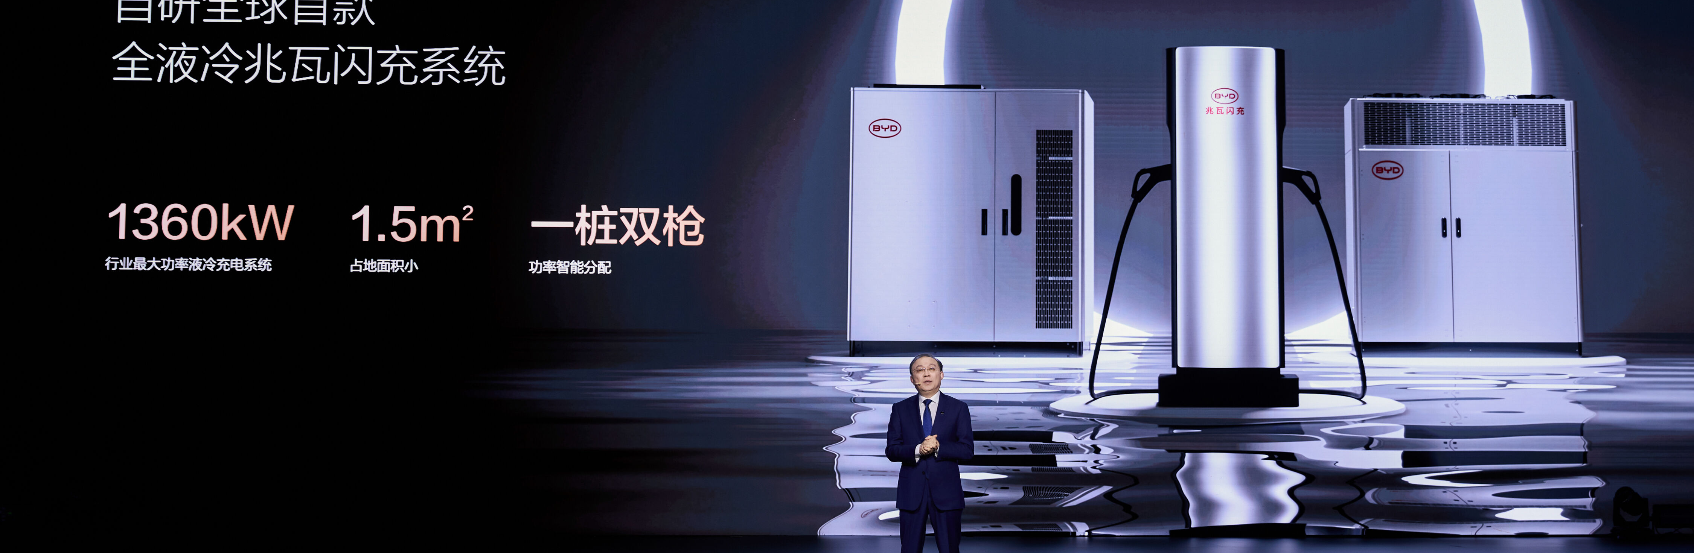
EV Adoption Makes Regional Economics More Important
Trend 2. Regional EV adoption changes the scale and coverage of the proposed diagnostics service.
25%
>55%
of global new-car sales
were electric in 2025
of EV battery capacity
deployed used LFP
BEV + PHEV
Global, 2025
Regional EV diagnostics
Our proposed focus by region
2025 electric-car share of new-car sales
Connect battery-health and charging data to help OEMs diagnose faults and reduce service downtime.
China, nearly 55%
Fleet-scale battery and charging monitoring.
Europe, 28%
Fault diagnosis across charging networks.
Service scale depends on the local EV fleet and access to OEM and charging-network data.
LFP = lithium iron phosphate
US, just under 10%
Targeted pilot for a selected model or fleet.
Proposed service
Regional EV diagnostics: reduce charging disruption. Track successful charge sessions and time to resolve battery or charging faults.
Sources: IEA; BYD
Case Study | State of Technology in Automotive
4
Notes:
IEA, electric cars
https://www.iea.org/reports/global-ev-outlook-2026/executive-summary
IEA, batteries
https://www.iea.org/reports/global-ev-outlook-2026/electric-vehicle-batteries
BYD, announcement and photo
https://www.byd.com/en/news-list/BYD-Unveils-Super-e-Platform-Megawatt-Flash-Charging-Electric-Vehicles-Matching-Refueling-Speeds.html
Assumptions and scope
- Regional percentages are 2025 electric-car shares of new-car sales, not shares of the installed fleet. Electric cars = BEV + PHEV.
- Regional service priorities are our assessment, not IEA recommendations. Validate them against the client’s local EV fleet, charging partners and fault history.
- LFP share uses battery capacity in newly registered EVs, excludes two- and three-wheelers, and includes LMFP.
- Agree successful-session definition, fault-resolution clock and baseline by region before setting targets.
- The BYD photo shows charger hardware. The station label is 1,360 kW. Announced vehicle charging peak is 1,000 kW.

Slide 5
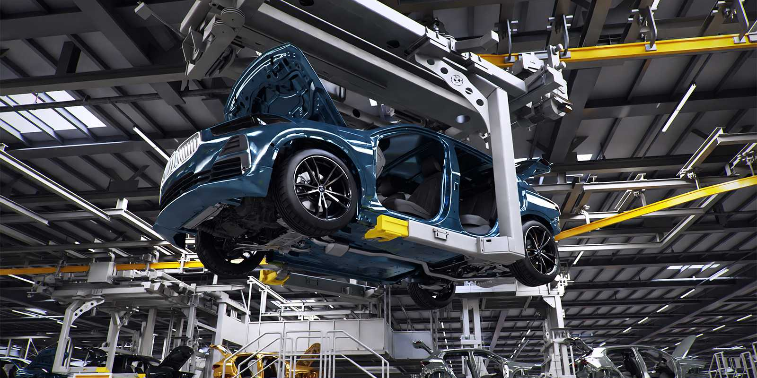
Digital Twins Help Plan Production Changes Before Installation
Trend 3. Virtual collision checks test proposed layouts before the physical production line changes.
Why it matters
New models and mixed powertrains raise plant complexity. Virtual testing can reveal clashes before a line changes.
Planning service scope
Connect CAD, plant-layout and equipment data. Simulate clearance and sequence changes before line modification.
BMW virtual collision checks
3 days
vs nearly 4 weeks
BMW comparison for collision checks. Digital-twin simulation.
Proposed service
Production-change simulation: find layout clashes before installation. Track collision-check lead time and clashes detected before physical changes.
Sources: BMW Group
Case Study | State of Technology in Automotive
5
Notes:
BMW Group, data and visualisation P90604065
https://www.press.bmwgroup.com/global/article/detail/T0450699EN?forceSitePreference=DESKTOP
Assumptions and scope
- Three days versus nearly four weeks is BMW’s collision-check comparison, not whole-factory lead time. The result relates to simulation rather than AI alone.
- Proposed service uses current CAD, equipment and plant-layout data. Model accuracy and version ownership need client agreement.
- Measure collision-check lead time for comparable change packages and record clashes resolved before installation. Agree baseline and scope before targets.

Slide 6
AI Improves Inspection and Process Control on Running Lines
Audi and Mercedes-Benz show how AI can improve ongoing production within defined processes.
Audi
Mercedes-Benz
IRIS label inspection
Rastatt topcoat process
~1 minute
20% less
of production time saved per vehicle
energy use in the affected topcoat process
Computer vision checks label content, language and placement at Ingolstadt and Neckarsulm.
AI-controlled process engineering monitors topcoat-booth sub-processes and replaces conventional controls.
Control retained: employee spot checks
Company-reported process result, June 2025
Proposed service
AI label inspection: reduce manual checking on a running line. Track seconds per vehicle, missed defects and false rejects. Agree quality limits with the client.
Sources: Audi; Mercedes-Benz
Case Study | State of Technology in Automotive
6
Notes:
Audi
https://www.audi.com/en/press-releases/artificial-intelligence-audi-boosts-production-efficiency-16674
Mercedes-Benz Portugal
https://media.mercedes-benz.pt/digital-sustentavel-eficiente-produco-bem-sucedida-do-novo-cla-na-fabrica-de-rastatt/
Assumptions and scope
- Both outcomes are company-reported and process-specific. Audi saves approximately one minute per vehicle. Mercedes-Benz reports 20% less energy in the affected topcoat process.
- Our preferred first project is label inspection at one station. Retain human review during a shadow-mode pilot and integrate results with the current quality system.
- Success: lower inspection time per vehicle while missed defects and false rejects meet client-approved limits. Agree labelled test set, sample size, evaluation period and quality limits before acceptance.
- Audi’s result is evidence of feasibility, not a promised saving for this client. No annual savings or numerical pilot target is assumed.

Slide 7
IT Providers Are Investing in Automotive Engineering
Selected announcements from 19 September 2025 to 19 September 2026.
Provider / date | Customer / platform | Scope of activity | Evidence status
Accenture 24 Jun 2026 | Coretura Truck OEM joint venture | Reusable commercial-vehicle software platform, including validation. | Signed agreement. Coretura retains architecture ownership.
Capgemini 29 Jun 2026 | Bentley Motors | Manufacturing and back-office integration, data foundations and IT operations. | Underway. No quantified outcome disclosed.
TCS 24 Aug 2026 | Porsche AG | Five-year AI deal, proposed AI centre and proposed MHP acquisition. | Announced. Approvals required at announcement.
DXC Luxoft 7 Jan 2026 | AMBER platform | Software for infotainment, displays and connectivity, including AI. | Product launch. No named AMBER production deployment.
Our assessment: vehicle-software platforms appear crowded (Coretura and AMBER). Differentiate through a narrow plant inspection service that works with the OEM’s existing systems.
Proposed service
Plant AI integration and support: address label-check delays. Demonstrate inspection time and quality on one station before agreeing a broader contract.
Sources: Accenture; Capgemini; TCS; Porsche; DXC
Case Study | State of Technology in Automotive
7
Notes:
Accenture
https://newsroom.accenture.com/news/2026/coretura-and-accenture-join-forces-to-reinvent-the-development-of-software-defined-commercial-vehicles
Capgemini
https://www.capgemini.com/news/press-releases/capgemini-supports-bentley-motors-in-the-acceleration-of-its-future-digital-strategy/
TCS
https://www.tcs.com/who-we-are/newsroom/press-release/tcs-porsche-ag-partner-accelerate-future-of-ai-powered-mobility
Porsche
https://pnr-prd2-pub1.newsroom.porsche.com/en/2026/company/porsche-mhp-sale-tata-consultancy-services-43113.html
DXC
https://dxc.com/newsroom/01072026-dxc-introduces-next-gen-automotive-software-platform-amber-at-ces-2026
Assumptions and scope
- Window: 19 September 2025–19 September 2026. Dates and status refer to cited announcements. TCS’s approval condition is as of announcement.
- Crowding is our qualitative assessment of this selected sample, not a market-share study. Coretura and AMBER indicate established platform competition. The examples do not prove an absence of plant-AI competitors.
- Proposed differentiation: integrate a specific inspection workflow with existing plant systems and show time and quality results. No competitor or client ROI is assumed.
- Agree missed-defect and false-reject limits, inspection-time baseline and integration scope with the client.

Slide 8
Thank You
Recommended starting project: AI label inspection at one production station.
Managed AI Label Inspection
Check label content, language and placement. Run alongside current inspection with human review.
Feasibility
Customer value
Available evidence
A single station offers a contained pilot. It needs less initial scope than a vehicle-release program or a full plant twin.
Reduce manual inspection time while maintaining label quality. Fit the service into the existing quality workflow.
Audi reports about one minute saved per vehicle. That supports a pilot, but does not establish this client’s saving.
Success criterion to agree with the client
Inspection time falls while missed defects and false rejects meet client-approved limits. Agree the baseline, test sample and evaluation period before acceptance.
Key question
Can the OEM provide representative label images, inspection results and a station owner for a controlled pilot?
Sources: Audi. Opportunity selection and comparisons are our assessment.
Case Study | State of Technology in Automotive
8
Notes:
Audi
https://www.audi.com/en/press-releases/artificial-intelligence-audi-boosts-production-efficiency-16674
Assumptions and scope
- Preferred opportunity is our assessment using feasibility, customer value and available evidence. It assumes the client has a relevant label-checking task and can provide data and site access.
- Compared with the alternatives: SDV release work needs OEM test-environment access. Digital twins need current CAD and plant models. Regional EV diagnostics need fleet and charging-network data. Label inspection can be tested on one existing station.
- Audit errors and inspection time in shadow mode with human review. Agree the labelled test set, baseline, sample size, evaluation period, missed-defect limit and false-reject limit with the client.
- Do not extrapolate Audi’s one-minute result. No numerical target, guaranteed ROI or implied contract commitment is assumed.

